Slide 1
Software Design and Architecture
State Pattern

Slide 2
Design principles
High-level principles
‣ Single Responsibility
‣ Open/Closed
‣ Liskov Substitution Principle
‣ Interface Segregation
‣ Dependency Inversion
Low-level principles
‣ Encapsulate what varies
‣ Program to interfaces, not implementations
‣ Favor composition over inheritance
‣ Strive for loose coupling

Slide 3
State
Behavioral Patterns
observer
decorator
strategy
command
template
null object
state
Creational Patterns
factory method
abstract factory
singleton
Structural Patterns
adapter
facade

Slide 4
Problem
Methods that have large, multipart conditional statements that depend on the object's state are difficult to maintain and extend

Slide 5
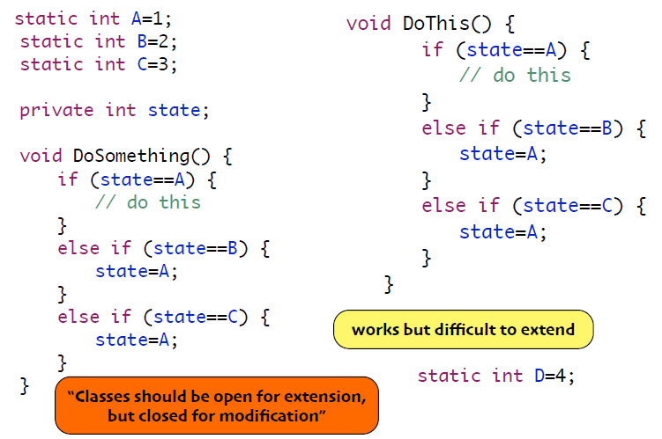
Example

Slide 6
State Pattern
The State Pattern allows an object to alter its behavior when its internal state changes. The object will appear to change its class.
If we associate a class with behavior, then
since the state pattern allows an object to change its behavior
it will seem as if the object is an instance of a different class each time it changes state

Slide 7
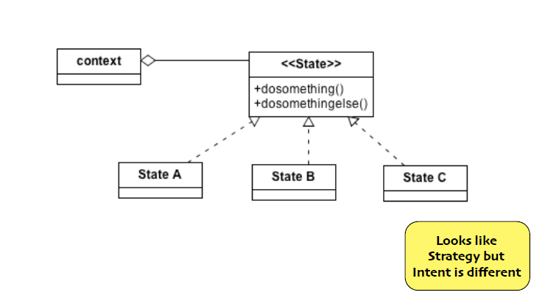
Class Diagram

Slide 8
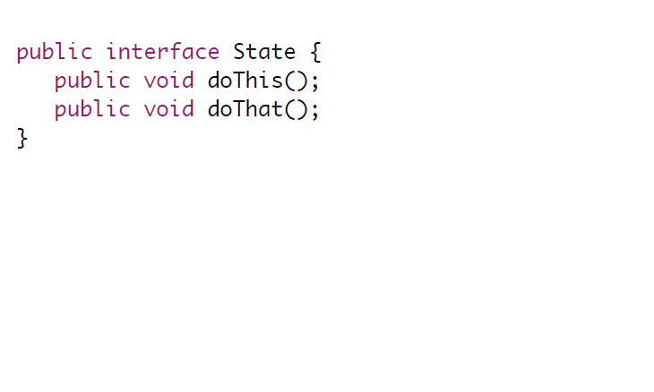
State Interface

Slide 9
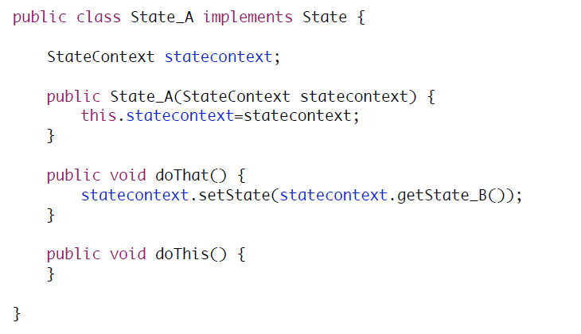
State_A

Slide 10
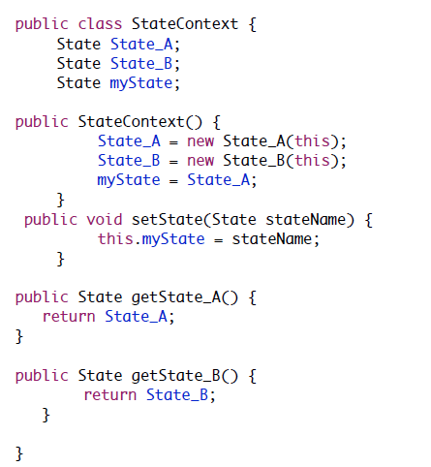
context

Slide 11
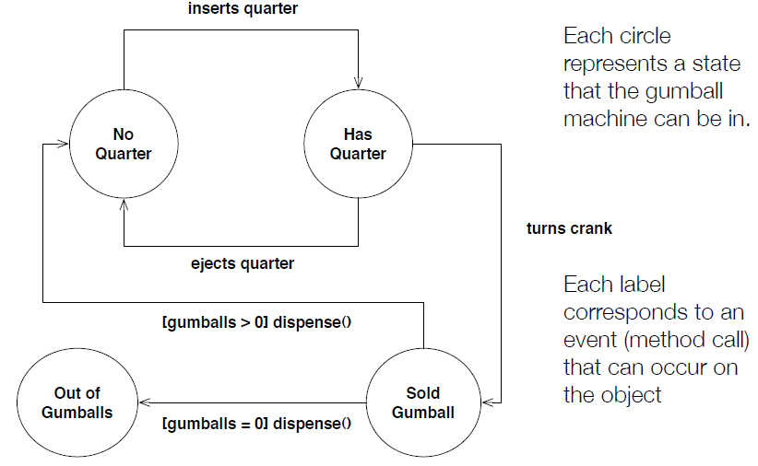
Example: State Machines for Gumball Machines

Slide 12
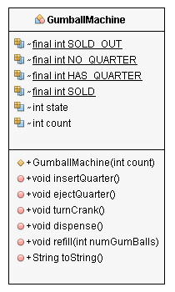
Example: State Machines for Gumball Machines

Slide 13
Problems with the First Design
• Does not support Open Closed Principle
• A change to the state machine requires a change to the original class
• You can’t place new state machine behavior in an extension of the original class
• The design is not very object-oriented: indeed no objects at all except for the one that represents the state machine, in our case GumballMachine.
• State transitions are not explicit; they are hidden amongst a ton of conditional code
• We have not “encapsulated what varies”

Slide 14
Design with State Pattern
1. Create a State interface that has one method per state transition
2. Create one class per state in state machine. Each such class implements the State interface and provides the correct behavior for each action in that state

Slide 15
Design with State Pattern: State Interface
public interface State {
public void insertQuarter();
public void ejectQuarter();
public void turnCrank();
public void dispense();
}

Slide 16
Design with State Pattern: NoQuarterState Class
public class NoQuarterState implements State {
GumballMachine gumballMachine;
public NoQuarterState(GumballMachine gumballMachine) {
this.gumballMachine = gumballMachine;
}
public void insertQuarter() {
System.out.println("You inserted a quarter");
gumballMachine.setState(gumballMachine.getHasQuarterState());
}
public void ejectQuarter() {
System.out.println("You haven't inserted a quarter");
}
public void turnCrank() {
System.out.println("You turned, but there's no quarter");
}
public void dispense() {
System.out.println("You need to pay first");
}
public String toString() {
return "waiting for quarter";
}
}

Slide 17
Design with State Pattern: HasQuarterState Class
import java.util.Random;
public class HasQuarterState implements State {
GumballMachine gumballMachine;
public HasQuarterState(GumballMachine gumballMachine) {
this.gumballMachine = gumballMachine;
}
public void insertQuarter() {
System.out.println("You can't insert another quarter");
}
public void ejectQuarter() {
System.out.println("Quarter returned");
gumballMachine.setState(gumballMachine.getNoQuarterState());
}
public void turnCrank() {
System.out.println("You turned...");
gumballMachine.setState(gumballMachine.getSoldState());
}
public void dispense() {
System.out.println("No gumball dispensed");
}
public String toString() {
return "waiting for turn of crank";
}
}

Slide 18
Design with State Pattern: SoldState Class
public class SoldState implements State {
GumballMachine gumballMachine;
public SoldState(GumballMachine gumballMachine) {
this.gumballMachine = gumballMachine;
}
public void insertQuarter() {
System.out.println("Please wait, we're already giving you a gumball");
}
public void ejectQuarter() {
System.out.println("Sorry, you already turned the crank");
}
public void turnCrank() {
System.out.println("Turning twice doesn't get you another gumball!");
}
public void dispense() {
gumballMachine.releaseBall();
if (gumballMachine.getCount() > 0) {
gumballMachine.setState(gumballMachine.getNoQuarterState());
} else {
System.out.println("Oops, out of gumballs!");
gumballMachine.setState(gumballMachine.getSoldOutState());
}
}
public String toString() {
return "dispensing a gumball";
}
}

Slide 19
Design with State Pattern: SoldOutState Class
public class SoldOutState implements State {
GumballMachine gumballMachine;
public SoldOutState(GumballMachine gumballMachine) {
this.gumballMachine = gumballMachine;
}
public void insertQuarter() {
System.out.println("You can't insert a quarter, the machine is sold out");
}
public void ejectQuarter() {
System.out.println("You can't eject, you haven't inserted a quarter yet");
}
public void turnCrank() {
System.out.println("You turned, but there are no gumballs");
}
public void dispense() {
System.out.println("No gumball dispensed");
}
public String toString() {
return "sold out";
}
}

Slide 20
Design with State Pattern
3. Change GumballMachine class to point at an instance of one of the State implementations and delegate all calls to that class. An action may change the current state of the GumballMachine by making it point at a different State implementation

Slide 21
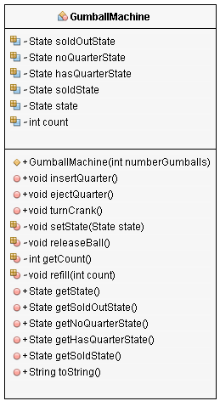
Design with State Pattern: GumballMachine Class

Slide 22
Implement a New State: WinnerState
• Add a new State implementation: WinnerState
• Exactly like SoldState except that its dispense() method will dispense two gumballs from the machine, checking to make sure that the gumball machine has at least two gumballs
• You can have WinnerState be a subclass of SoldState and just override the dispense() method
• Update HasQuarterState to generate random number between 1 and 10
• if number == 1, then switch to an instance of WinnerState else an instance of SoldState

Slide 23
Design with State Pattern: WinnerState Class
public class WinnerState extends SoldState {
public WinnerState(GumballMachine gumballMachine) {
super(gumballMachine);
}
public void dispense() {
System.out.println("YOU'RE A WINNER! Two gumballs for your quarter.");
gumballMachine.releaseBall();
if (gumballMachine.getCount() == 0) {
gumballMachine.setState(gumballMachine.getSoldOutState());
} else {
gumballMachine.releaseBall();
if (gumballMachine.getCount() > 0) {
gumballMachine.setState(gumballMachine.getNoQuarterState());
} else {
System.out.println("Oops, out of gumballs!");
gumballMachine.setState(gumballMachine.getSoldOutState());
}
}
}

Slide 24
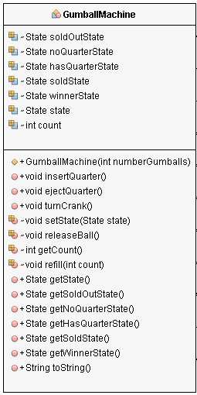
Design with State Pattern: GumballMachine Class

